Slide 1

DATABASE MANAGEMENT SYSTEM PROJECT
Team-4A17

Slide 2

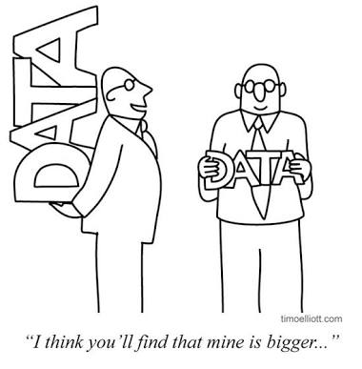
APPLIANCE STORE Management System
Team-4A17
Team members
Anusha Raikar
Apoorva Jinde
Archana Badagi
Ashwini Banagar
USN
-01FE18BCS043
-01FE18BCS044
-01FE18BCS045
-01FE18BCS054

Slide 3
Role of team members
Anusha Raikar:
Collection of all data from the clients required for the project. ER to relational Mapping. Data Dictionary. Normatization ,GUI validations done. Bill Generation and notification system.
Apoorva Jinde:
Developing ER model for the management selected, ER to relational Mapping, Object Model , GUI implementation , Normatization , Exceptions handling, plotting graphs, Bill Generation and notification system.
Archana Badagi:
Developing ER model for the management selected,Collection of all data from the clients required for the project,Normatization ,Interaction with the client. GUI frames,connections based on URL pathing and bill generation.
Ashwini Banagar:
Developing ER model for the management selected. Normatization ,GUI frames, connections and documentation done, final ppt prepared and designing of the web pages, notification system .

Slide 4
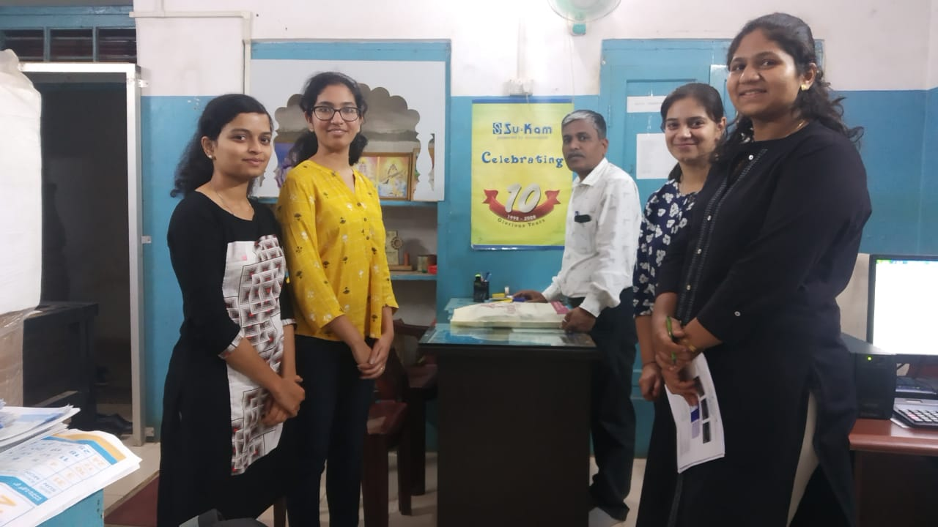
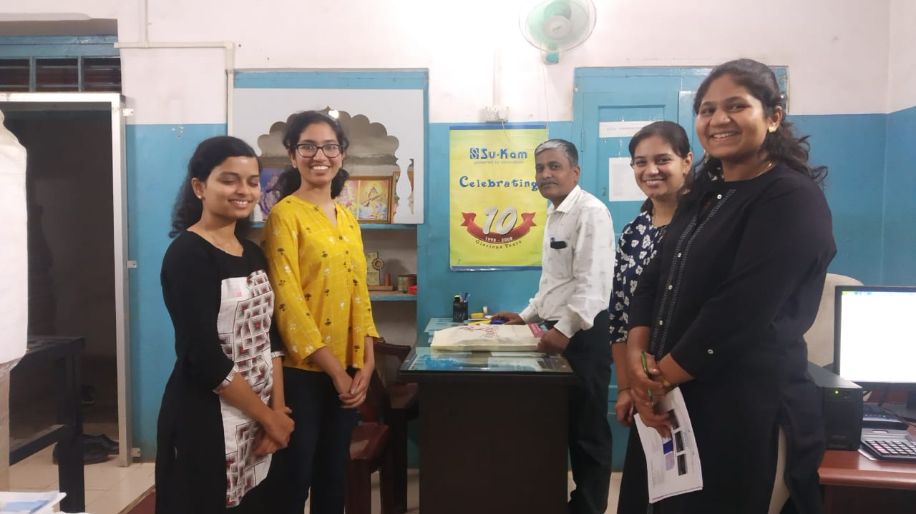
Client information SNAPSHOT WITH THE CLIENT
SINE WAVE CONTROL SYSTEMS
Sayed bldg, Opp: Lamington School,
Sir,Siddappa Kambali Marg (Lamington Road),
Hubballi-560020.
Ph: 0836-2369102, 9448206171.
E-mail:sinewavehubli@gmail.com
GSTIN:29AKMPB6295N1ZD.

Slide 5
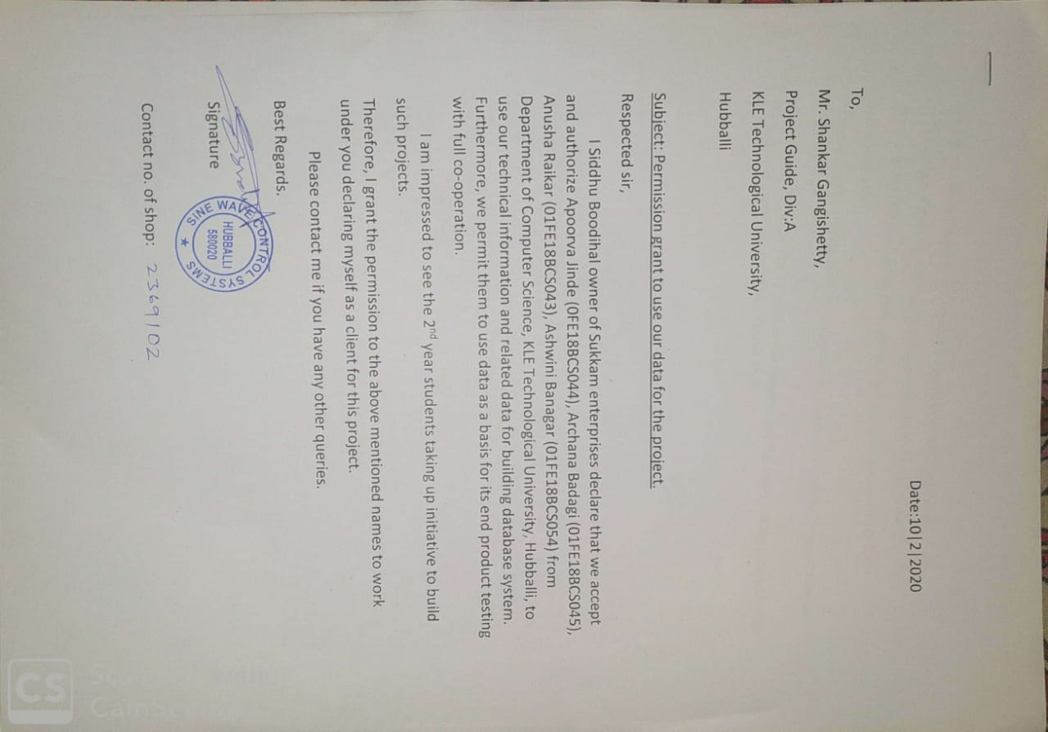
PERMISSION LETTER FROM CLIENT

Slide 6
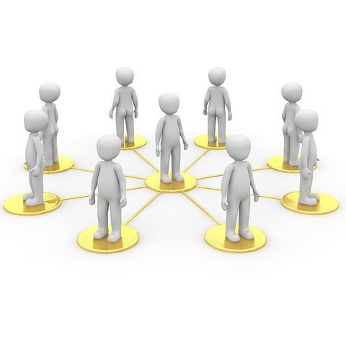

PROBLEM DESCRIPTION
We came across a problem that the shop has a huge collection of customer and supplier data which they were managing in ledgers and Excel sheets. They did not have any computerized system for now and the bill they generate was by entering the data in the cells of excel sheet. A lot of time is consumed during the process of business activity. And the customers who apply for AMC should be given services which they used to mark on calendar manually hence they would mess up having the wrong number of count of the services provided to customer. So we came up with the idea of providing them a computerized system to improve the efficiency and performance of their daily business activity.

Slide 7



functionality
Details of all the customers and employees.
Bill Generation
Notification to provide service to customer who have taken up AMC(Annual Maintenance Contract).
Proper security of all data.

Slide 8
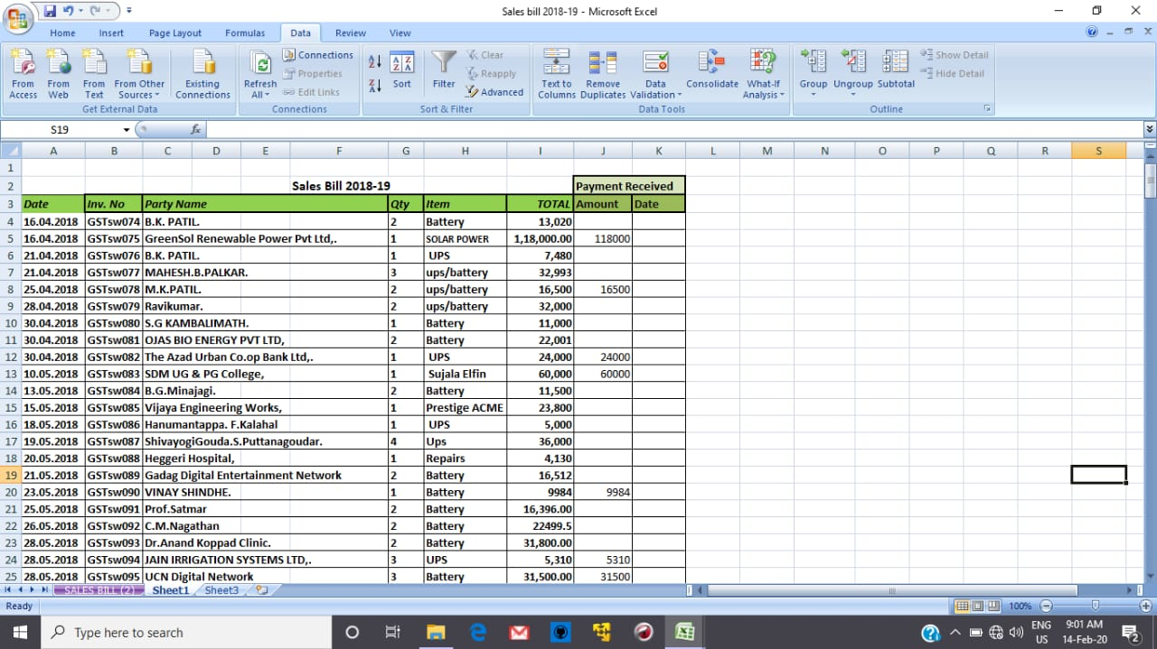
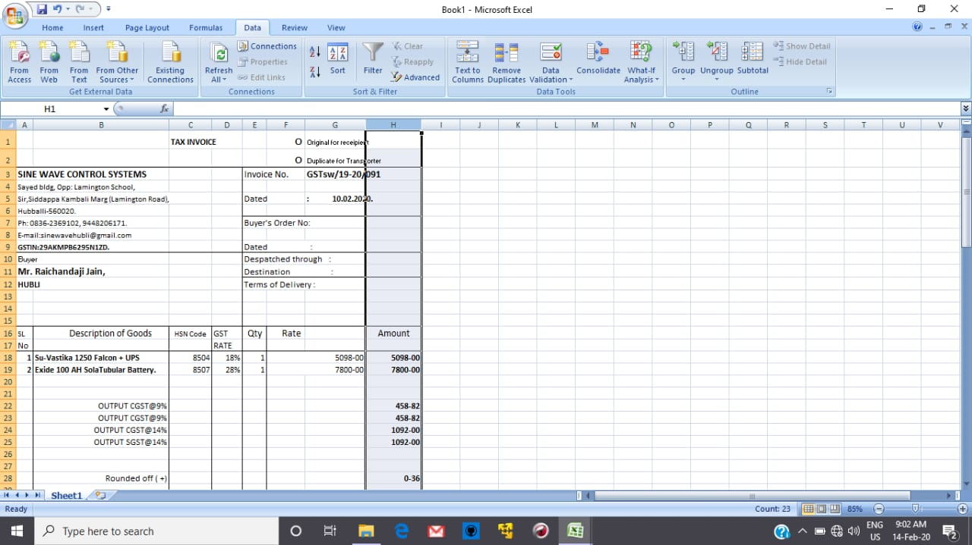
Actual Dataset Snapshots
Records are maintained in excel files and ledgers presently.

Slide 9
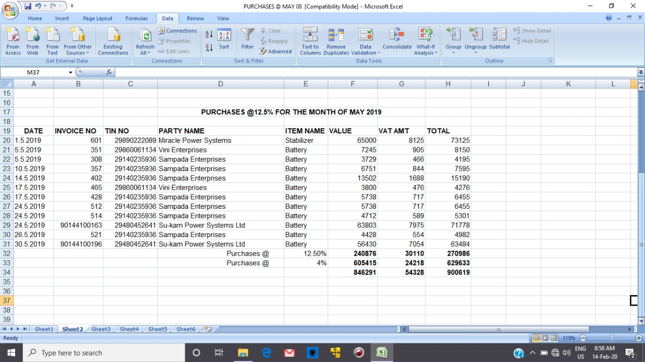
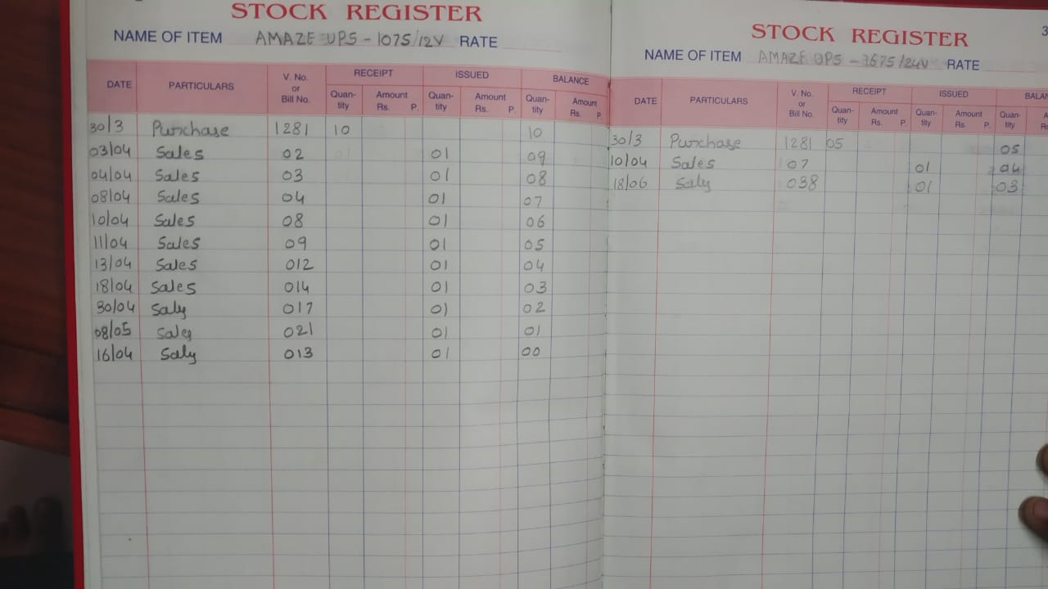
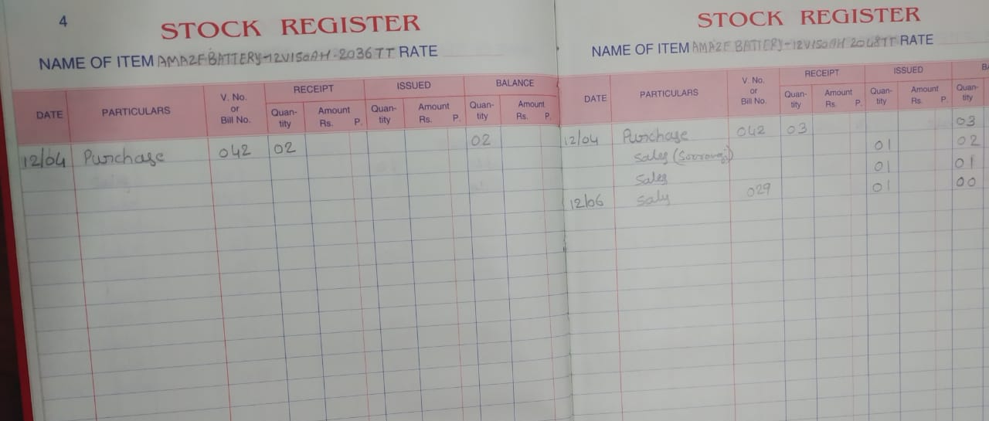

Slide 10
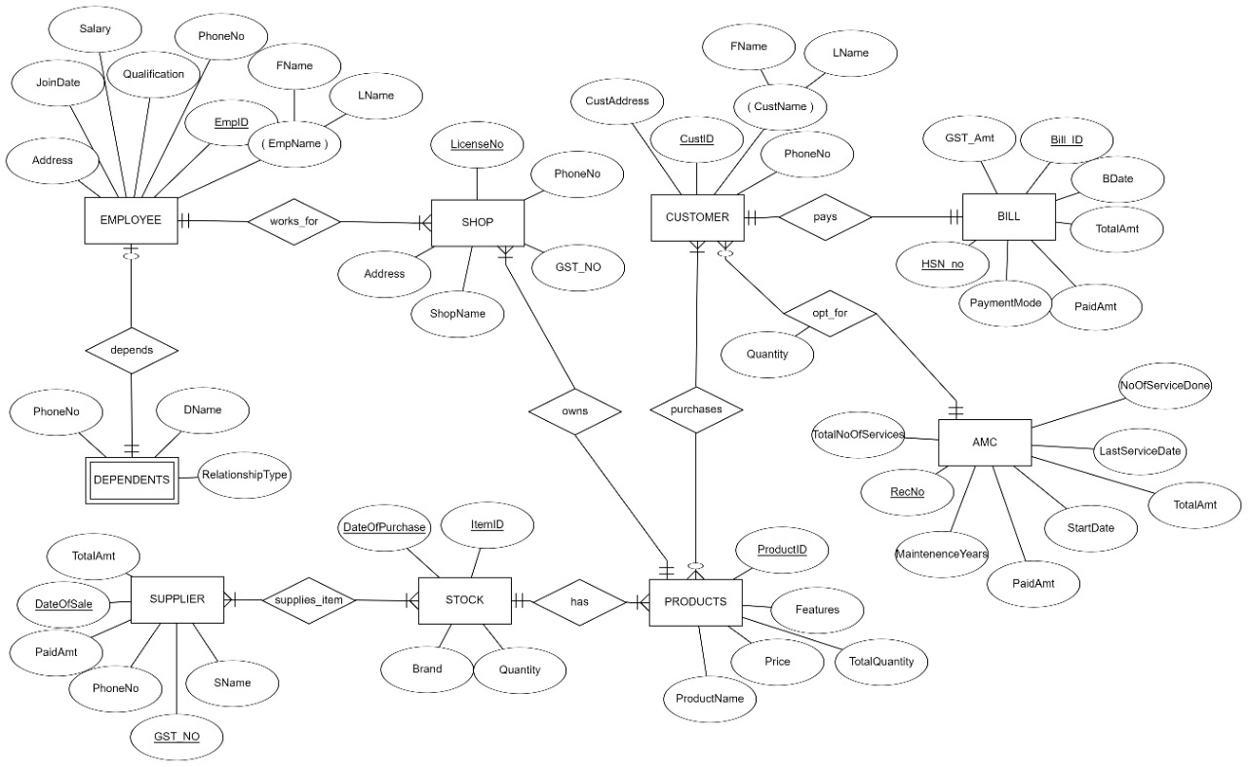
OUR OPTIONAL ER MODEL
DRAWBACK:
The same customer used to get different id’s
when they purchase
Products on different dates

Slide 11
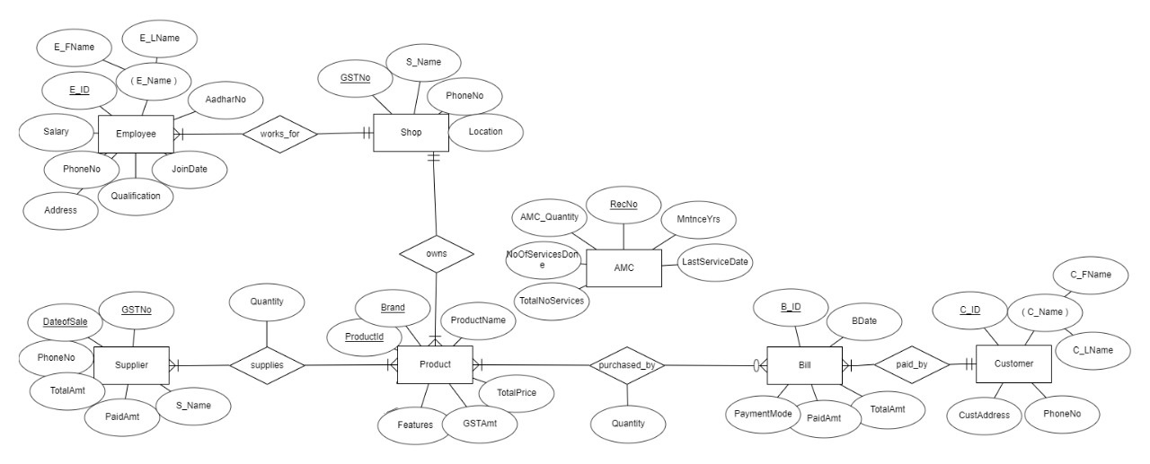
OPTIMAL ER DIAGRAM

Slide 12
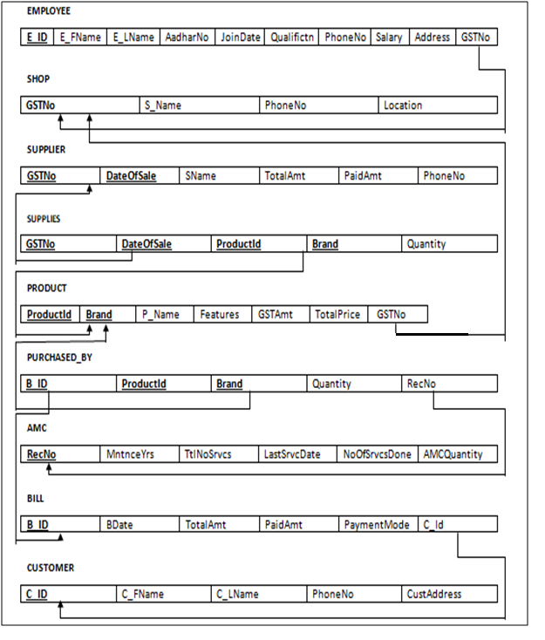
ER TO RELATIONAL MAPPING

Slide 13
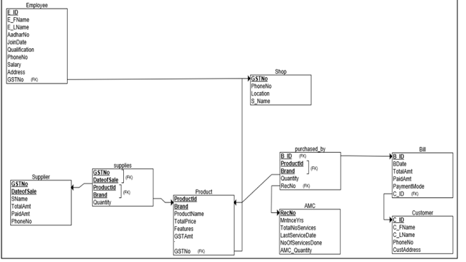
OBJECT MODEL

Slide 14
NORMALISATION
Entities:
Employee,Shop,Supplier,Supplies,Product,Purchased_by,AMC,Bill,Customer
The above entities have all its attributes as single or atomic values hence we conclude that the following relation is in 1NF

Slide 15
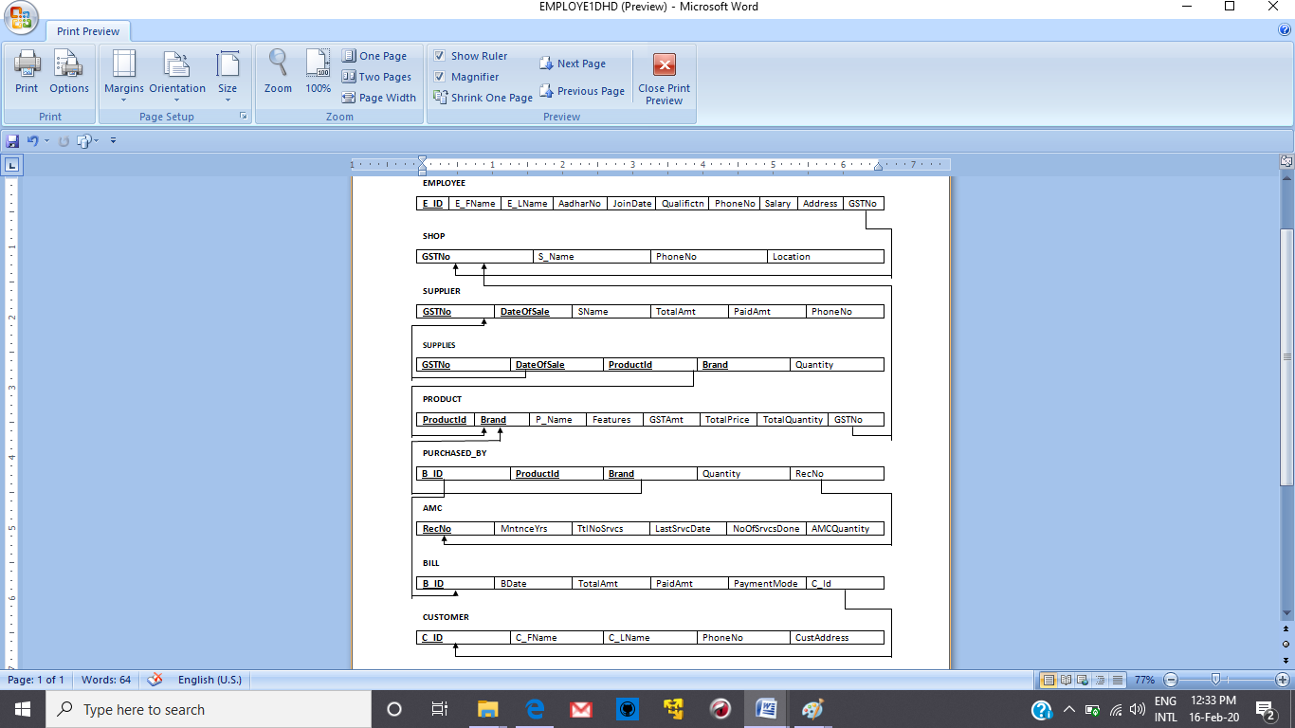
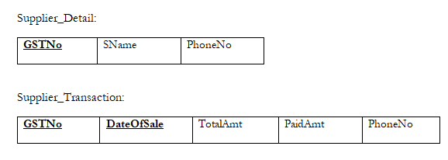
In the entity Supplier
1NF:The above entitiy has all its attributes as single or atomic values hence we conclude that the following relation is 1NF.
2NF:-FD1:{GSTNo}={GSTNo,SName,PhoneNo}
FD2:{GSTNo,date}={GSTNo,DateOfSale,TotalAmt,PaidAmt,PhoneNo }
This table can be decomposed into:
Considering the following two FD’s there doesn’t exist transitivity among the given FD’s and hence they are in 2NF at last.

Slide 16
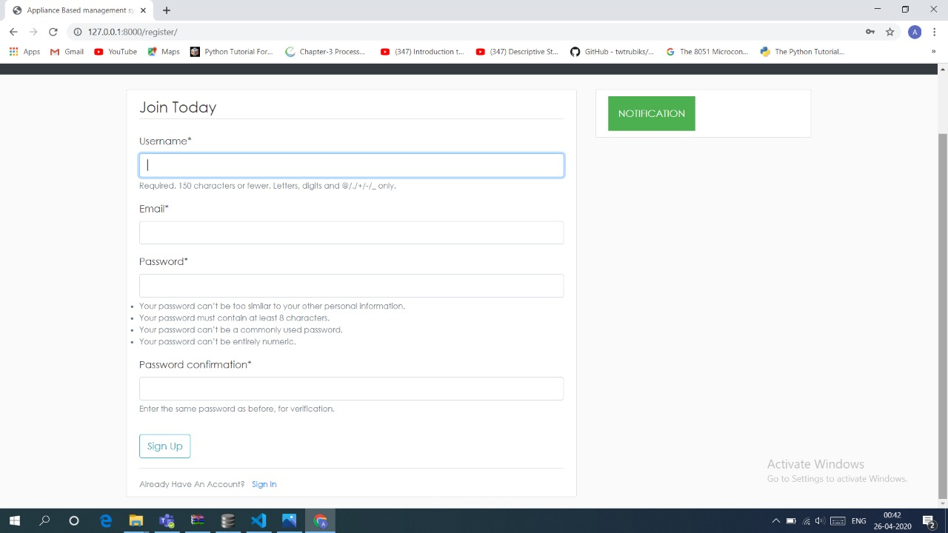
Here we can create our account

Slide 17
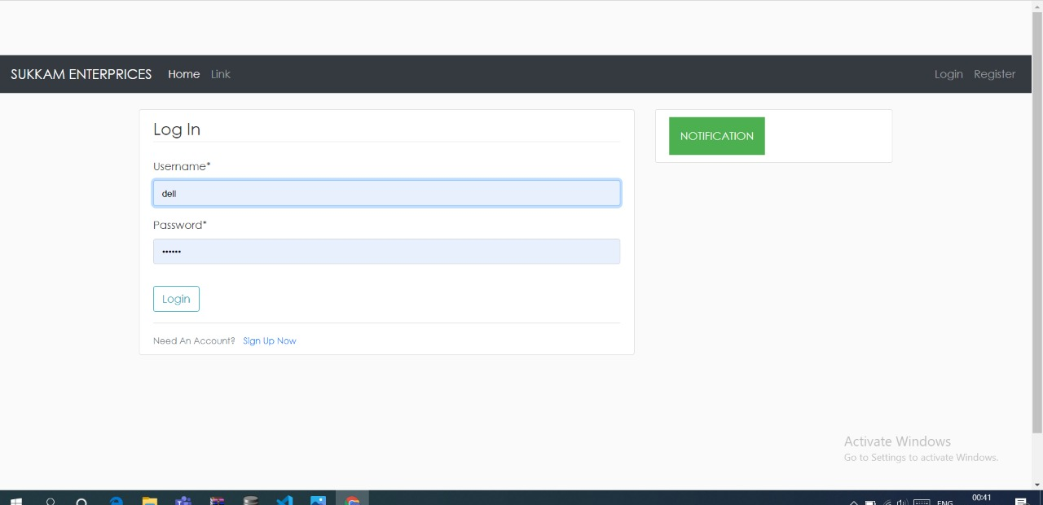
Here we can login to our system

Slide 18
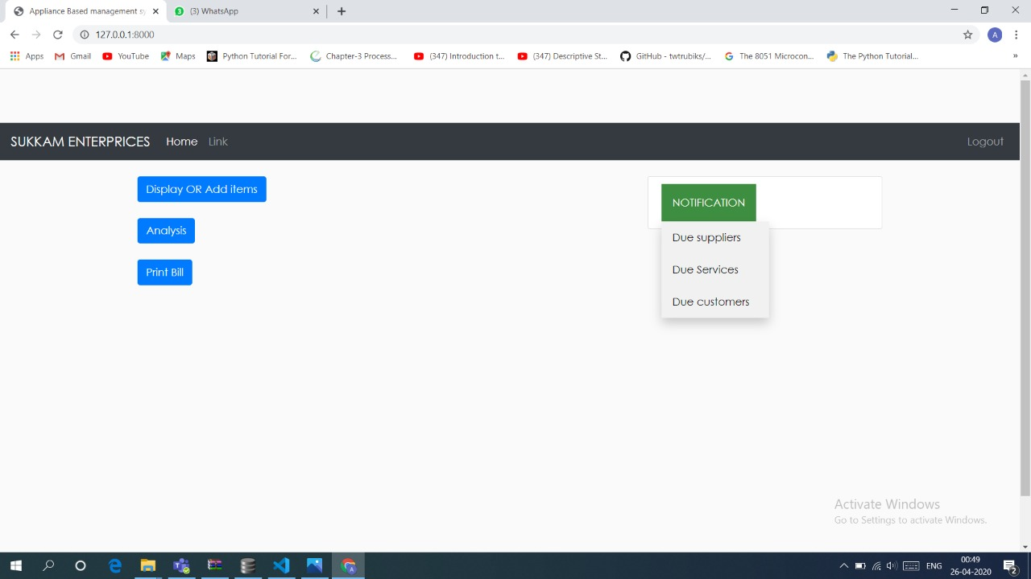
Notification System for Due Payments by suppliers and customers and also the notification for AMC Services
To add or view the details we have DISPLAY OR ADD ITEMS
To do analysis we need to cluck on ANALYSIS
To print Bill by entering the bill no we need to go to PRINT BILL Button

Slide 19
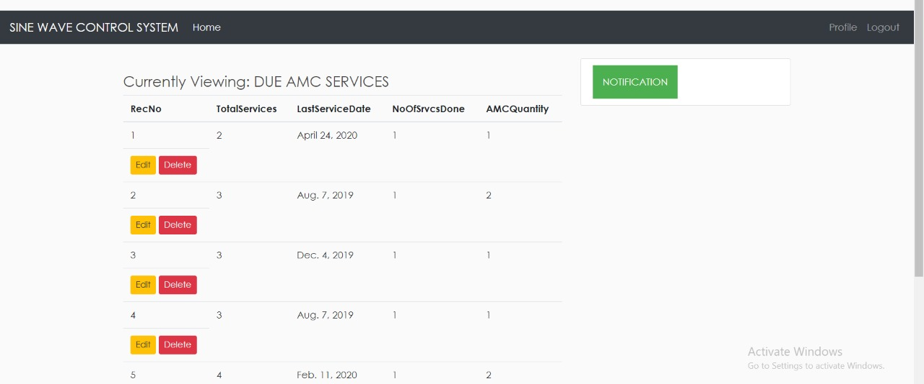
Here in pending amc we can view only those amc which are due not the one whose services have been completed

Slide 20
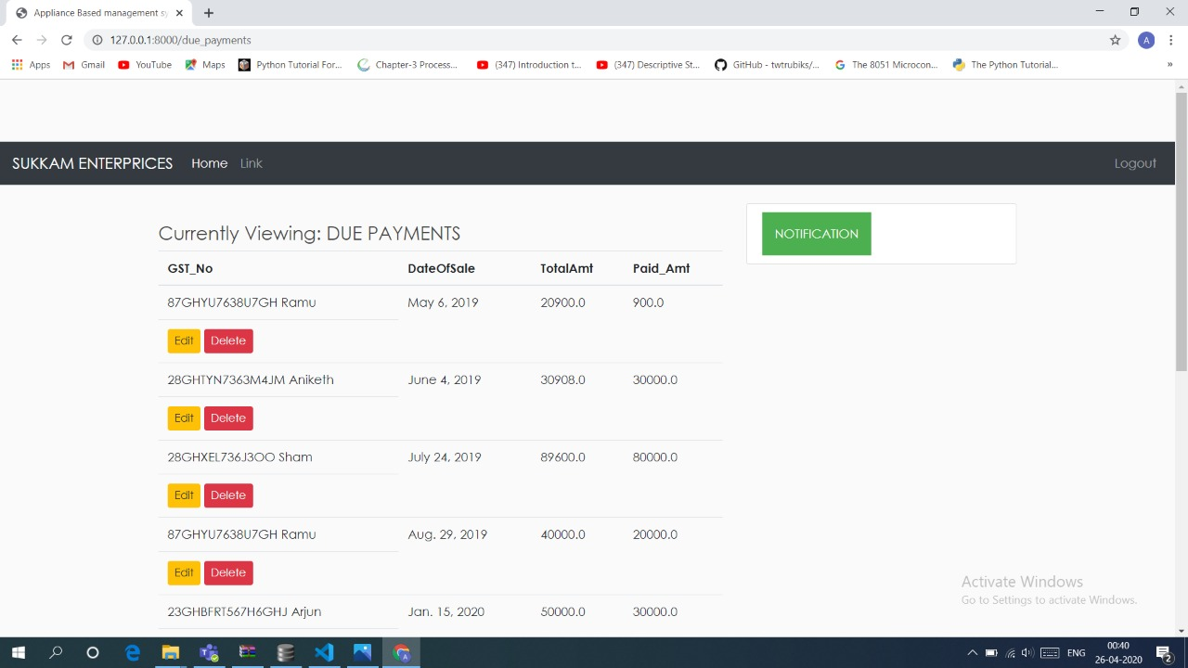
IN THIS WE CAN VIEW THE DUE PAYMENTS OF SUPPLIERS

Slide 21
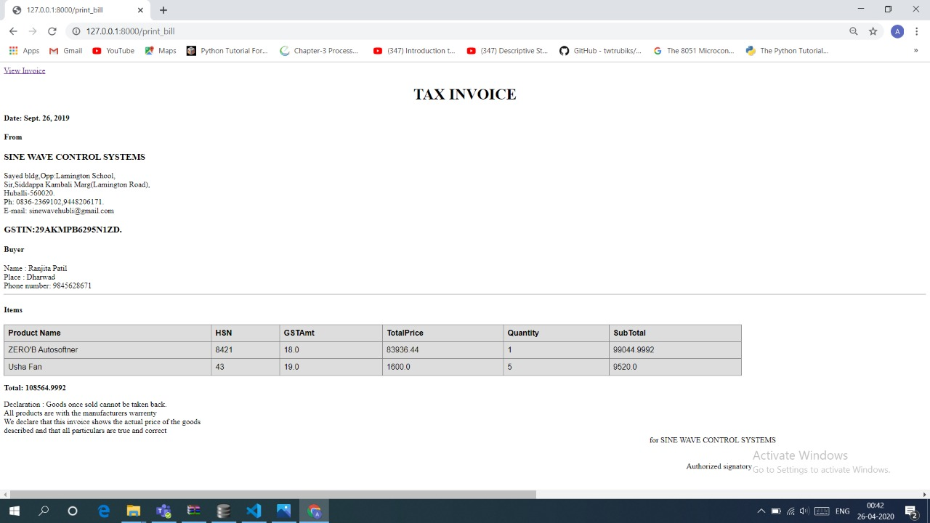
This Is The Page Of Bill Generation Clicking On View Invoice Renders It To Pdf

Slide 22
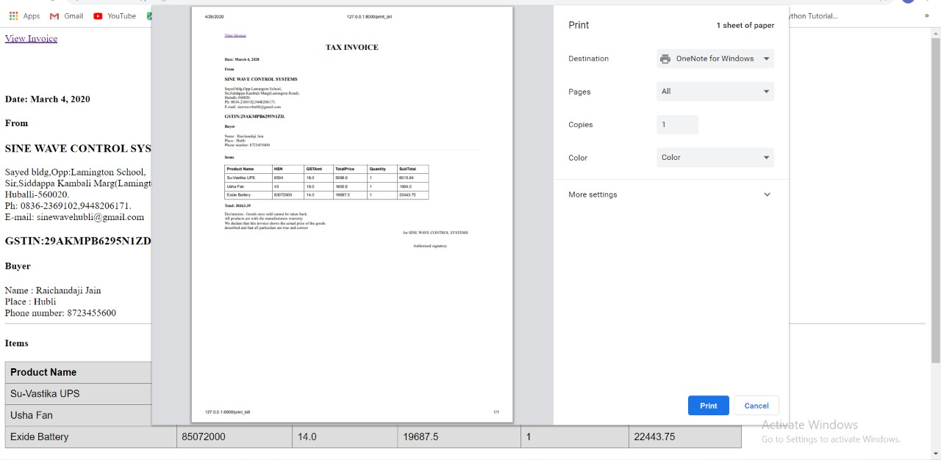

Slide 23
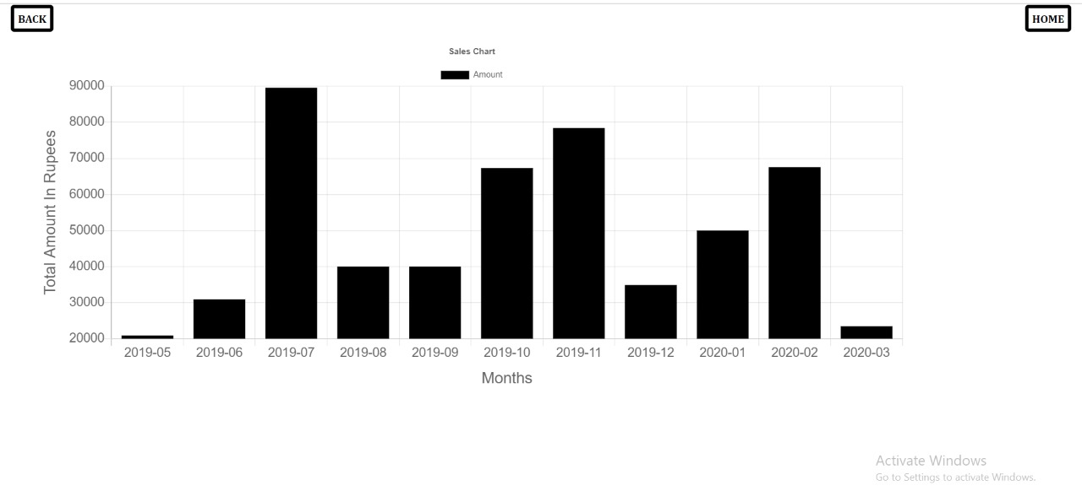
THIS IS THE ANNUAL REPORT OF SALES

Slide 24
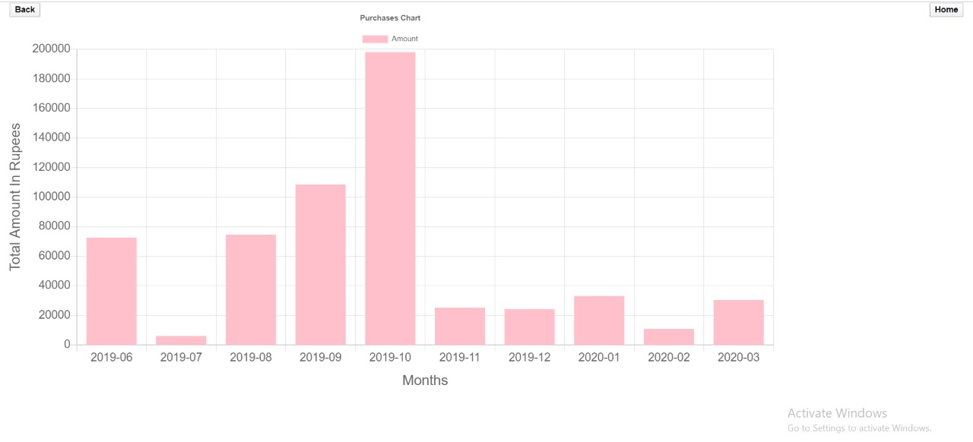
:
THIS IS THE ANNUAL REPORT OF PURCHASE

Slide 25
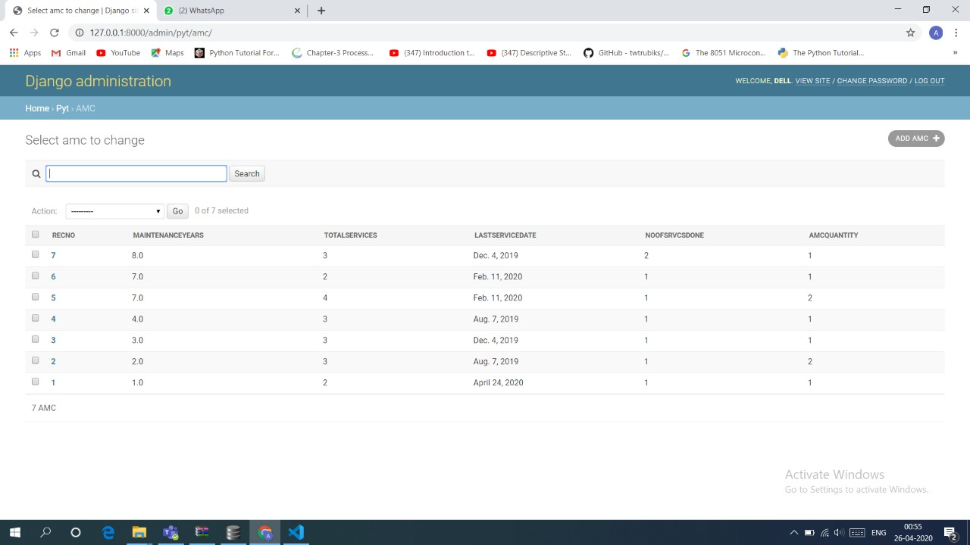
A FEW DATABASE SNAPSHOTS:
AMC DASHBOARD:

Slide 26
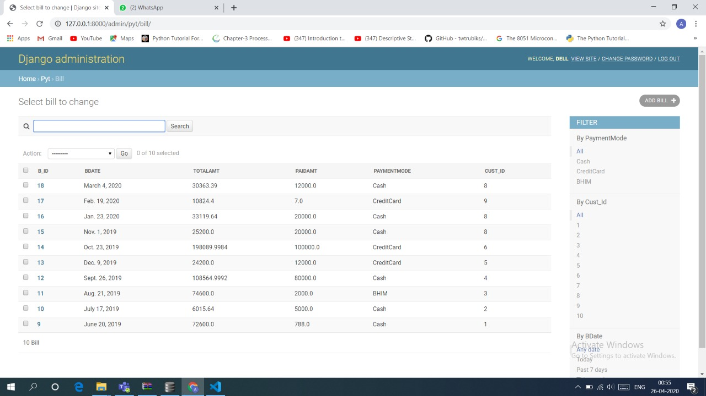
BILL DASHBOARD:

Slide 27
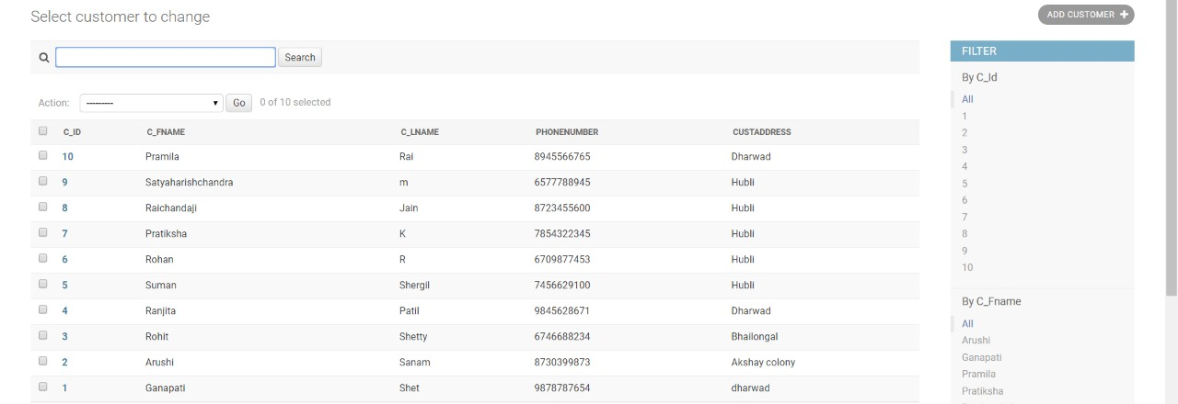
CUSTOMER DASHBOARD:

Slide 28
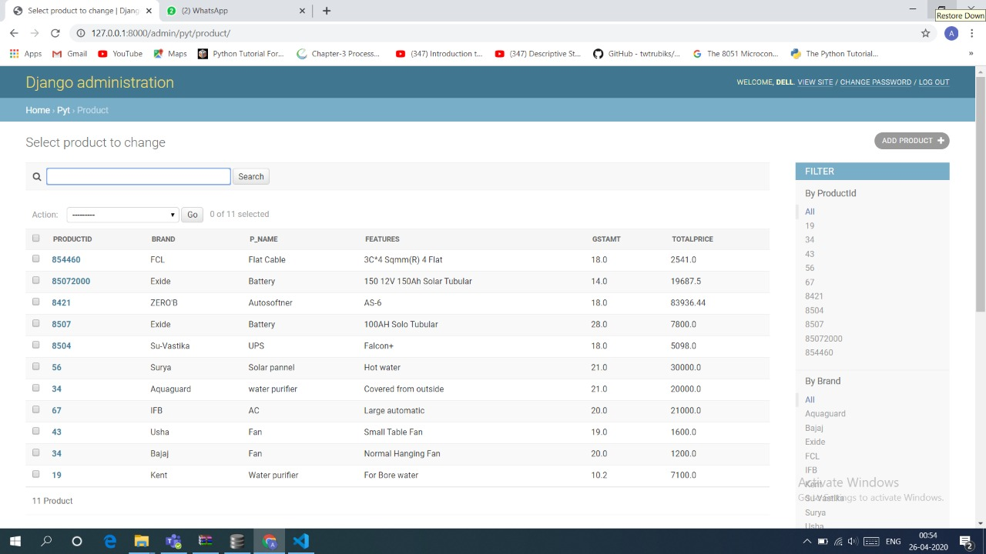
PRODUCTS DETAILS:

Slide 29
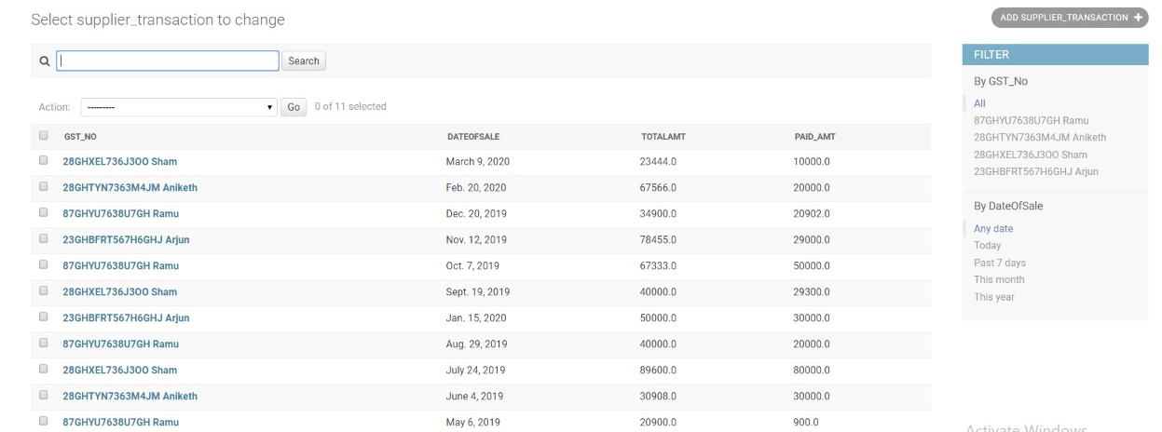
SUPPLIER TRANSACTIONS:

Slide 30
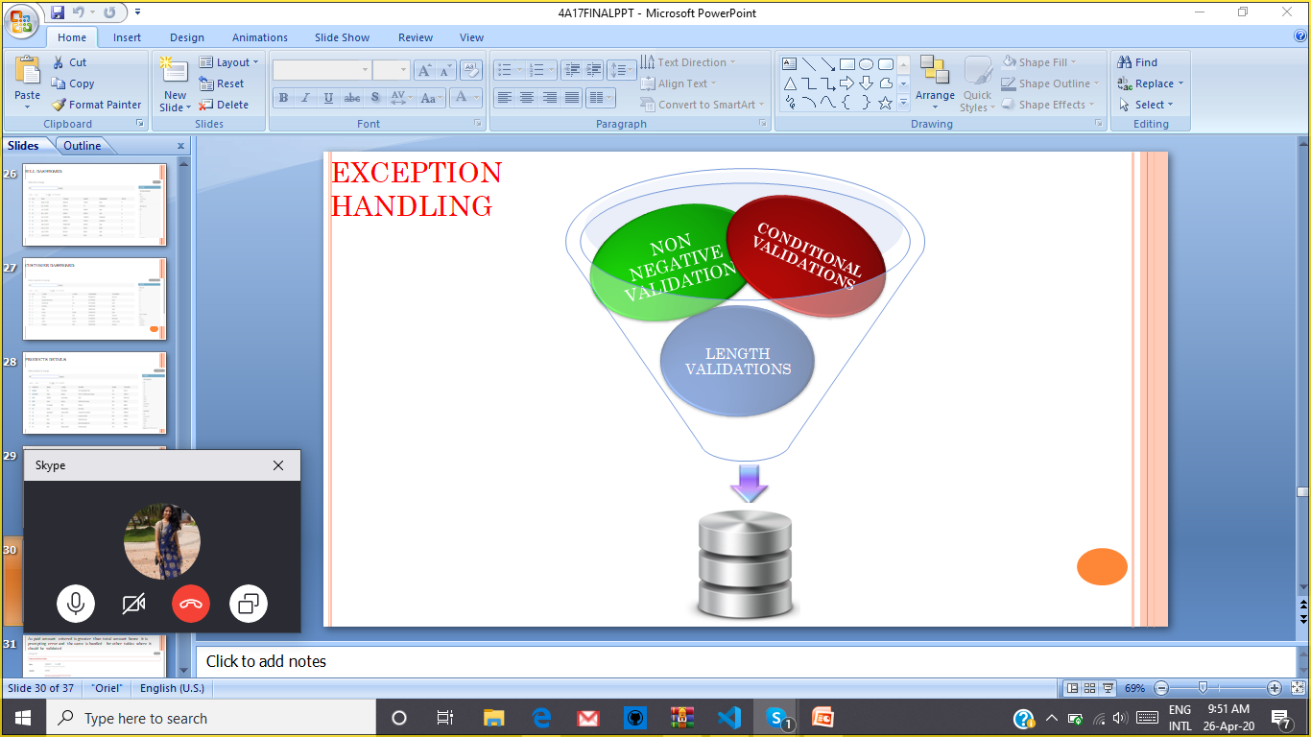

Slide 31
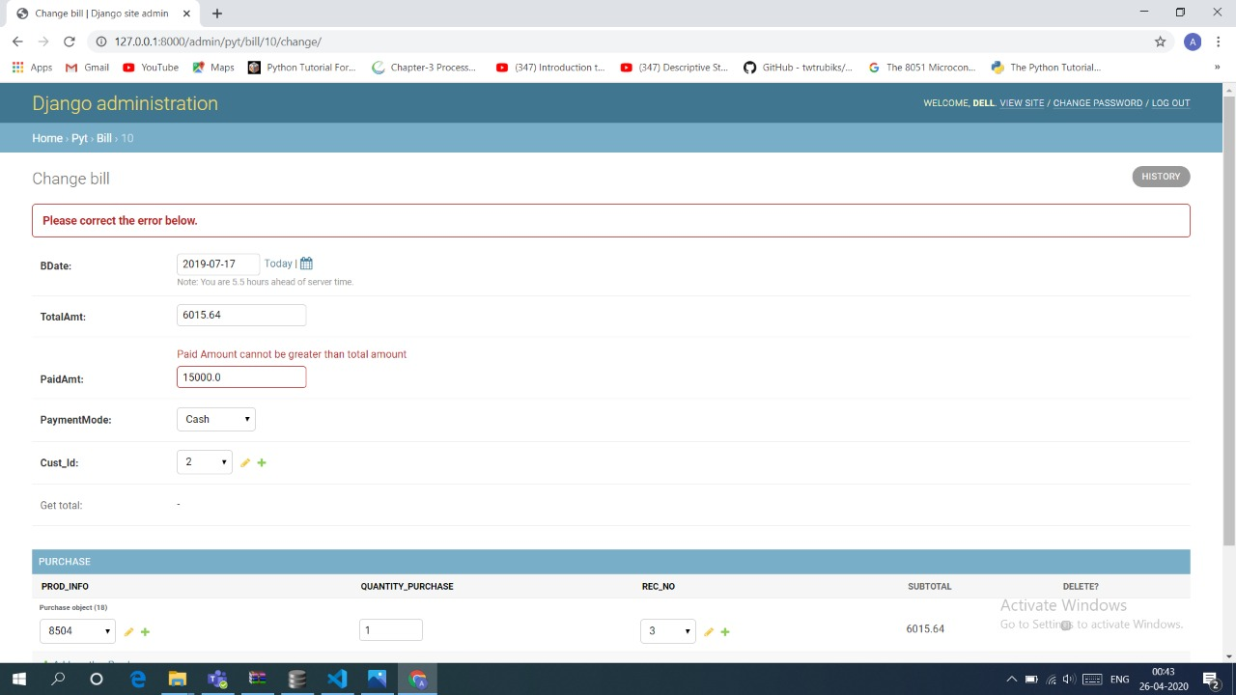
As paid amount entered is greater than total amount hence it is prompting error and the same is handled for other tables where it should be validated

Slide 32
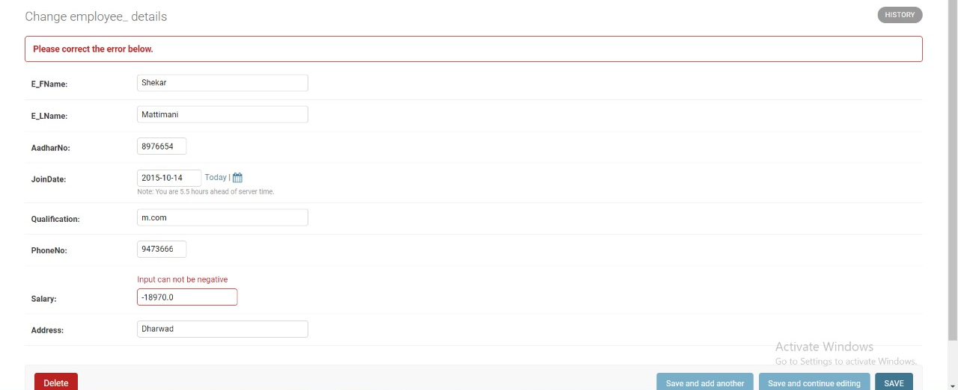
As many attributes cannot be negative therefore prompting error and this is handled through out all the tables:

Slide 33
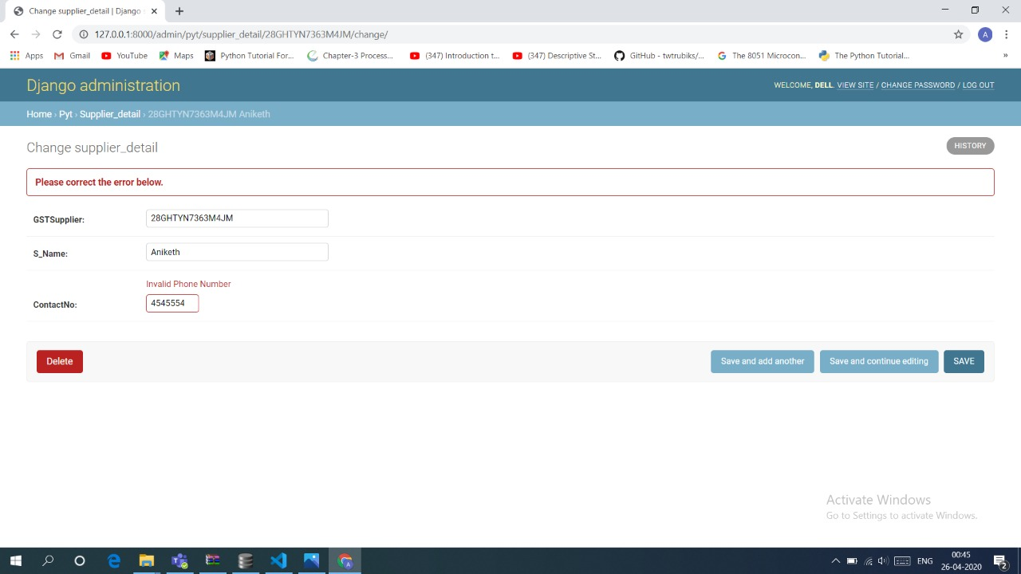
As it is an invalid phone number length and is less than 9000000000 hence prompting error and the same is handled in the other tables where phone number attribute is there.

Slide 34
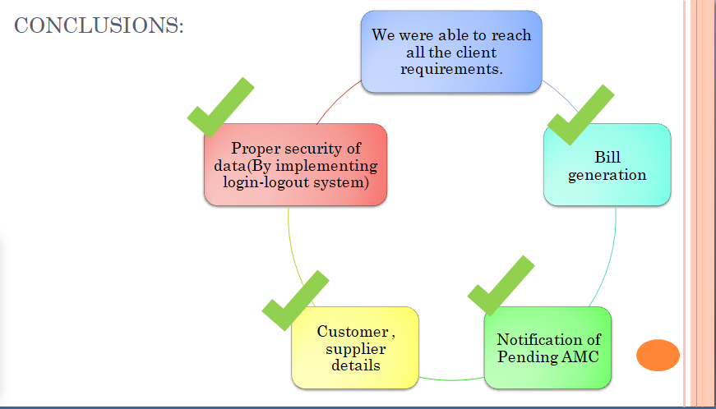
CONCLUSIONS:

Slide 35
References
Django official Documentations
YouTube videos of Telusko
GitHub
StackExchange for our few doubts

Slide 36

Team Experience
Even without meeting our team we still managed to interact with the team .We felt like we are doing some industrial project communicating via Skype ,Teams etc
We learnt about the techniques of building software
We got to know the real time application of SQL Queries
Working in
teams was
a great
Experience
We learnt web designing using javascript .

Slide 37

THANK YOU

